Slide 1
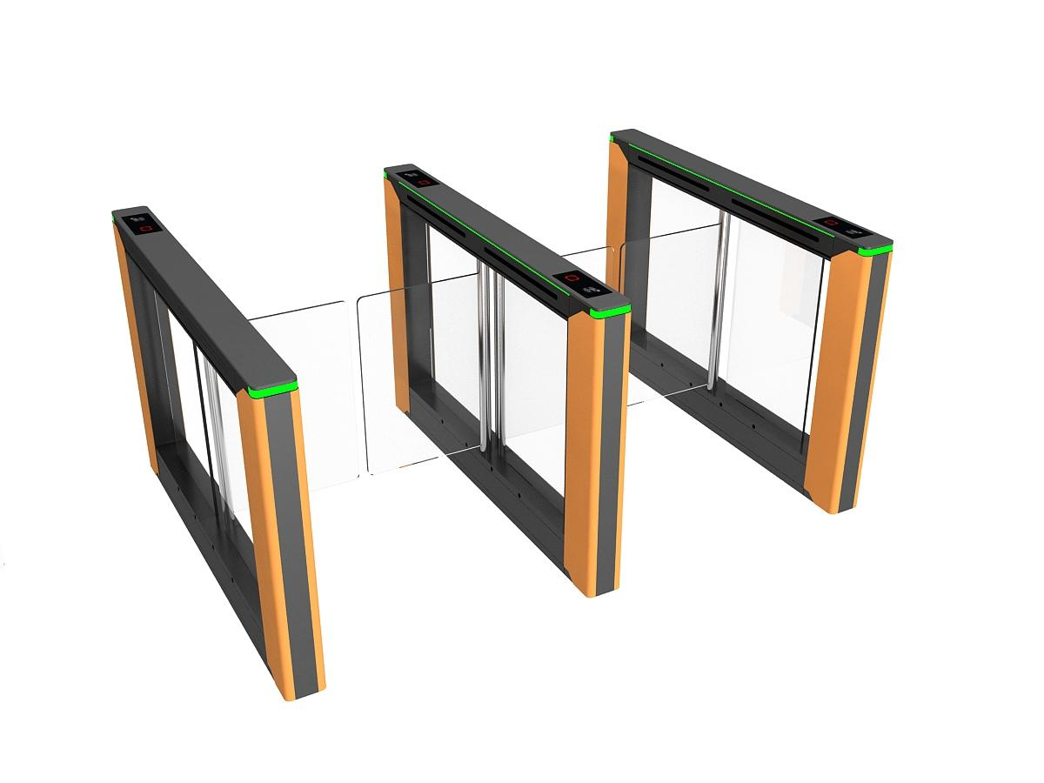
New Pattern of Global Pedestrian Access Gate Market (2026 Edition)
GLOBAL PEDESTRIAN ACCESS GATE MARKET ANALYSIS · 2026 EDITION
Conclusion Data of Global Pedestrian Access Gate Market (2024-2025)
New Market Pattern Driven by Technological Innovation and Urbanization

Slide 2

ContentsCONTENTS
01
Executive Summary
Core Insights & Market Outlook
02
Global Market Overview
Size, Growth & Key Drivers
03
Regional Market Structure
Share & Potential by Continent
04
In-depth Regional Analysis
APAC, Europe, North America
05
Product Types & Pricing
Swing Gates, Flap Barriers, Speed Gates
06
User Demand Characteristics
Developed vs. Emerging Markets

Slide 3




01 Executive Summary: Core Insights & Market Outlook
Steady Market Expansion
• 2024 Revenue$725M| 2031 Forecast$953M
• CAGR:4.0%(2025-2031)
• Metro Gates: Higher potential (CAGR5.48%)
APAC Dominates Globally
• Market share:45.2%(No.1 globally)
• Driver: China's smart city push & infrastructure upgrades
Tech Convergence as Main Theme
• Integration: Contactless + Biometrics + AI Anti-tailgating
• Trend: Toward "Smart, Multi-functional, Integrated" terminals
Diversified Market Landscape
• Global: APAC leads; Europe/US mature; Emerging catch up
• Demand: Developed (custom/compliance); Emerging (cost/security)

Slide 4

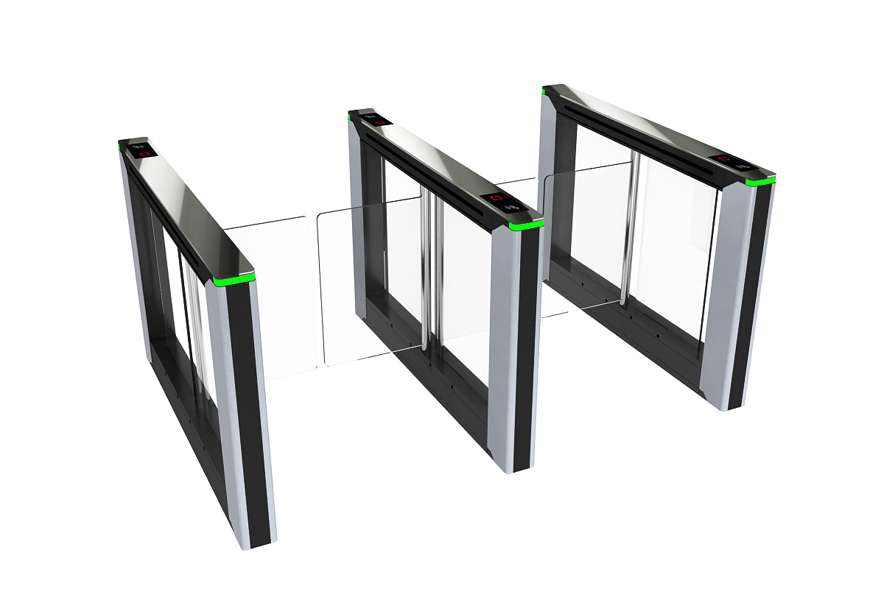
01 Executive Summary: Strategic Recommendations
Technological Innovation
Market Deepening
Ecosystem Building
Invest in biometrics & AI R&D to enhance intelligence.
Key:Multi-modal · Anti-tailgating · Behavior Analysis
Differentiated strategies for developed & emerging markets.
Key:High-end customization vs Cost-effective
Cooperate with integrators for end-to-end solutions.
Key:Open Platform · API · Data Linkage
Clear Product Structure Layering
35.2%
Swing Gates · Leader
Widest Applicability
28.7%
Flap Barriers · Efficient
High Traffic Scenarios
12.6%
Speed Gates · Fastest Growth
High-end Market Core

Slide 5
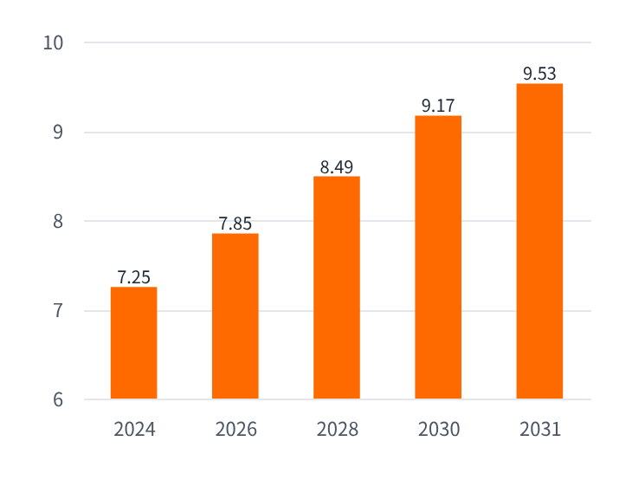

02 Global Market Overview: Market Size & Growth Trend
Global Smart Access Control Turnstile Market
Global Market Size Trend (2024-2031)
Unit: Billion USD
725MUSD
2024 Market Size
953MUSD
2031 Forecast
4.0%
CAGR
Core Segment: Metro Turnstiles
2.22BUSD
2024 Market Size
3.40BUSD
2032 Forecast
5.48%
CAGR

Slide 6

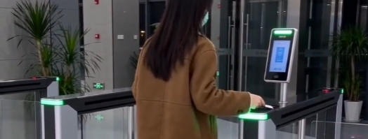
02 Global Market Overview: Core Driving Factors (1/2)
01Macroeconomy & Urbanization
02Tech Iteration & Innovation
•Africa, Asia & Latin America:Rapid urbanization drives large-scale public transport infrastructure.
•Smart City Construction:Projects prioritize efficient personnel access management.
•Contactless Tech:QR/NFC/Bluetooth enhance experience.
•Biometrics:Face/palm recognition enable frictionless access.
•AI Empowerment:Anti-tailgating & analysis upgrade turnstiles.

Slide 7

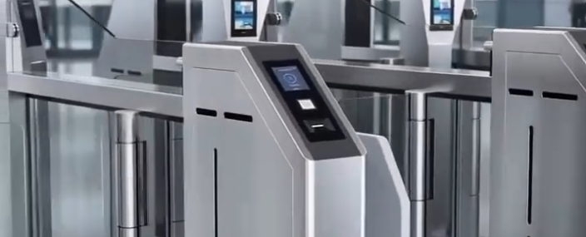
02 Global Market Overview: Key Drivers (2/2)
03Policy Support & Capital Investment
04Upgrading Application Scenario Needs
● Government-led Investment:Governments, especially in emerging economies, prioritize public transport and infrastructure in national development strategies.
● Rising Security Standards:Growing public safety awareness drives the replacement of old turnstiles and demand for high-security products.
● From Access to Management:Needs evolve from single access control to comprehensive platforms for efficiency, management and data operations.
● Diversified Scenarios:Expanding rapidly from offices/residential areas to airports, stations, stadiums, smart parks, construction sites, etc.

Slide 8
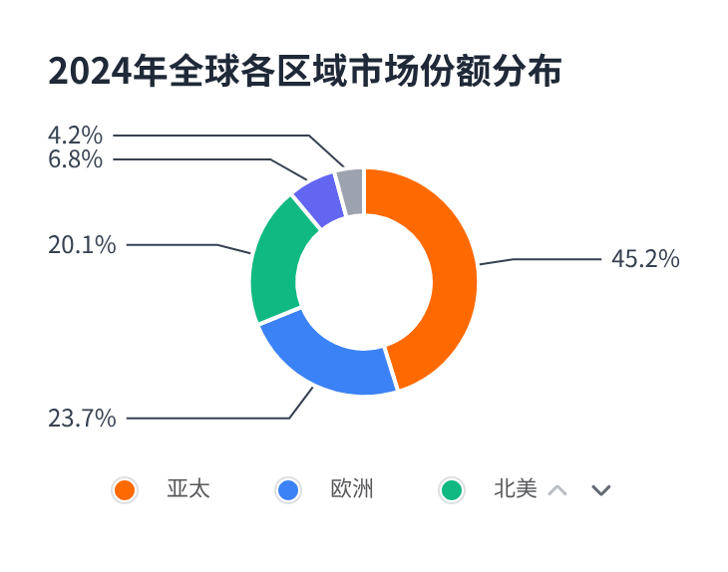


03 Regional Pattern Analysis of the Global Market
The global market shows obvious regional differentiation, with the Asia-Pacific region becoming the absolute core with nearly half of the share.
Asia-Pacific: "Locomotive" of Global Growth
Largest share at45.2%, with fastest CAGR of5.8%, leading global expansion.
Europe & NA: "Ballast" of Mature Markets
Over40%combined share, mature pattern with steady growth of 4.2% (NA) and 3.9% (Europe).
Emerging Markets: "Potential Stocks"
M.E. & Africa (CAGR6.3%) has huge potential; Latin America (6.8%) is also climbing steadily.

Slide 9



03 Global Market Regional Pattern Analysis: Data Overview
Asia Pacific
Europe
North America
Latin America
M.E. & Africa
45.2%
Market Share (2024)
23.7%
Market Share (2024)
20.1%
Market Share (2024)
6.8%
Market Share (2024)
4.2%
Market Share (2024)
Smart Cities (China)
Urbanization (SEA)
Digital Transformation (India)
Smart Transport Hubs
GDPR Compliance
High-End Building Security
Airport Security Upgrade
Smart Park Construction
Biometrics Popularization
Smart Cities (Brazil/Mexico)
New Rail Transit
Basic Security Needs
Digital Transformation (ME)
Infra Upgrade (Africa)
Port/Govt Security
CAGR:5.8%
CAGR:3.9%
CAGR:4.2%
CAGR:5.1%
CAGR:6.3%

Slide 10
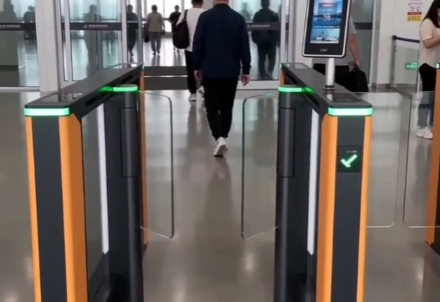
04 Regional Market Analysis: Asia Pacific – Global Core Growth Pole
Regional Characteristics:Large population base, rapid urbanization, high investment in smart cities. Chinese brands (top-tier brands like Jieshun, Fuji, Hikvision, Dahua, ZKTeco, etc.) hold over60%market share with overwhelming dominance.
China: World's Largest Single Market
Global Share38.7%| APAC Share85.6%
2024 Size: ~$338M(YoY +12.3%)
India | High-Growth Potential
CAGR up to7.2%. Demand is rapidly upgrading from low-end tripod turnstiles to smart swing gates and speed gates.
▎Product Structure
• Swing Gates (35.2%) / Flap Gates (28.7%)
• Tripod Turnstiles (18.5%) / Speed Gates (12.6%)
• Other Categories (5%)
▎Core Scenarios
• Rail Transit (38%) - Largest
• Commercial Complexes (22%)
• Smart Parks (18%) / Gov (10%)
Southeast Asia | Brand Hub
Steady growth (CAGR 6.8%). Chinese brands hold over60%market share with overwhelming tech & supply chain advantages.

Slide 11

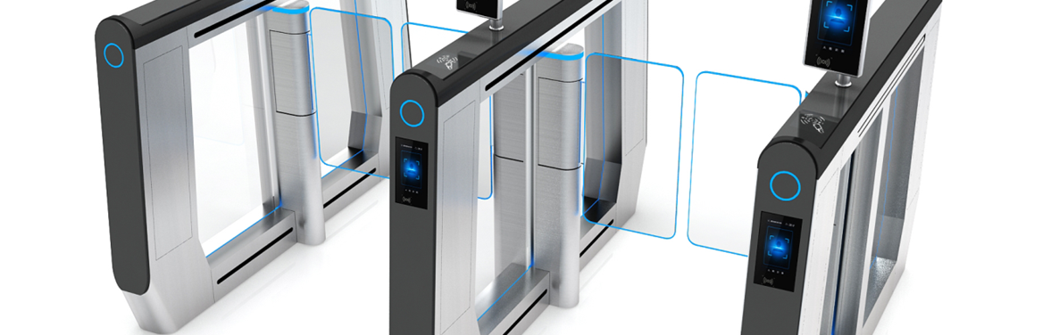

04 Regional Market Deep Dive: Europe — High-End Mature Market
Regional Characteristics:Mature & stable market with core features of “high-end, customized, compliant”. High entry barriers; strict compliance with EU CE certification & GDPR required.
🇩🇪 Germany: Core of European Tech R&D & Mfg
•Market Position:Largest single market (≈33.0% share).
•Market Size:≈$56M (2024), CAGR 3.7%.
•Key Insights:High-end smart products dominate; speed/swing gates (>60%) for airports, rail, Grade A offices.
🇬🇧 🇫🇷 UK/France: High-Value Core Markets
•Market Position:≈34.6% combined share (2nd to Germany).
•User Preferences:Prioritize privacy encryption & silent ops; loyal to established Western brands.
•Suggestions:Emphasize compliance & human-centered design.

Slide 12

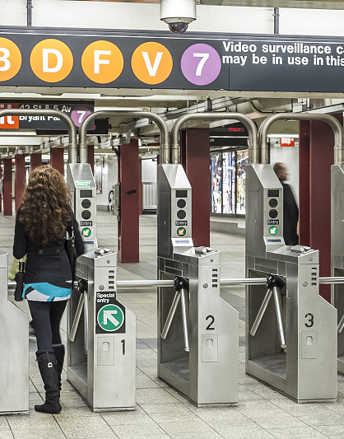
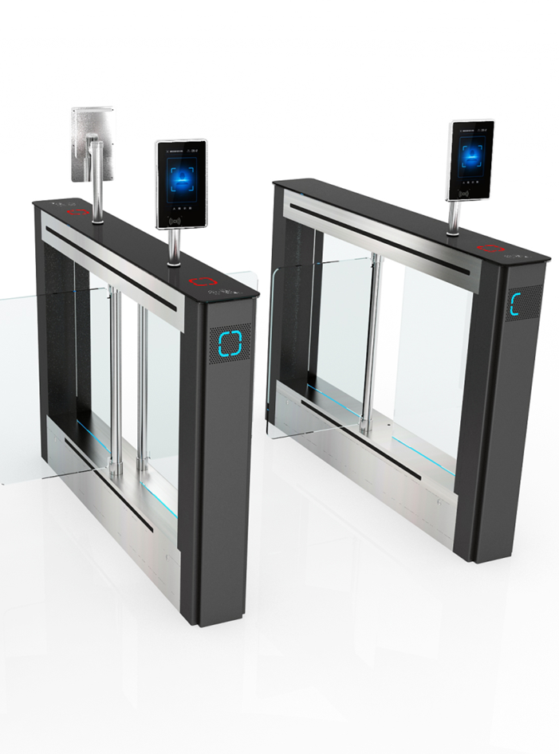
04 Regional Market Analysis: North America - Technology Leading Market
Regional Feature: Technology Highland & High-end Trend
In its 2017 report, ASCE rated U.S. infrastructure a "D+", indicating urgent need for renewal. By 2025, most pedestrian detection devices will reach end-of-life, creating a huge market gap.
Procurement focuses on cutting-edge tech (multi-modal biometrics, AI anti-tailgating, cloud platform). Mid-to-high-end models dominate, with high demand for innovation.
🇺🇸 USA: Core Market for Global High-end Turnstiles
17.1% / 85.1%
Global Share / NA Regional Share
$124M(CAGR 4.2%)
2024 Est. Market Size
▎Products & Scenarios:Mid-to-high-end demand >90% (swing 40%/flap 25%); Airport security & high-end offices (core, >55%).
▎Key Preferences:High demand for intelligence & durability; prefers integrated solutions with multi-modal biometrics, AI anti-tailgating & cloud management.

Slide 13
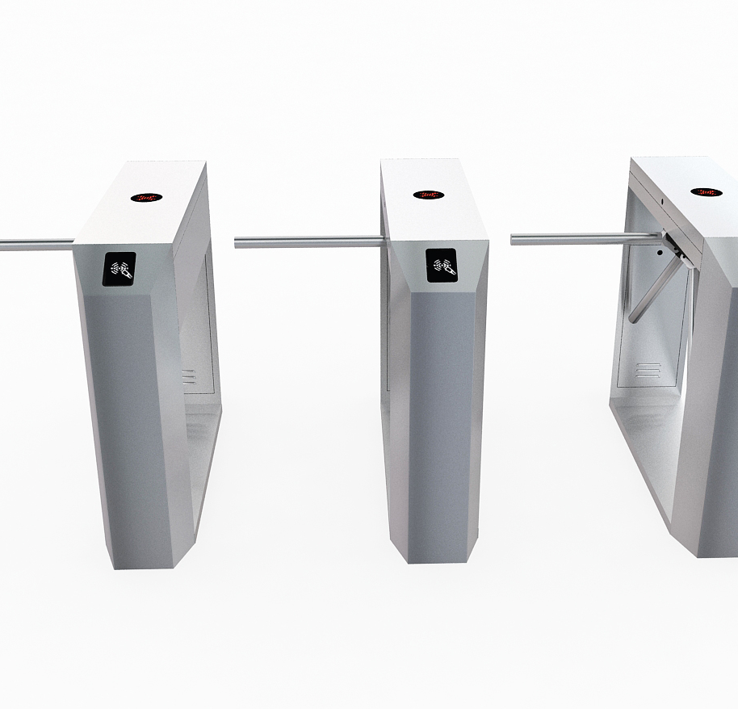

04 Regional Market Analysis: LATAM & MEA – High-Potential Emerging Markets
Latin America: Take-off Phase
MEA: Polarized Market
▌ Regional Features
Led by Brazil & Mexico, driven by urbanization & rail transit projects. Mid-low end products dominate; Chinese brands lead with cost-effectiveness.
▌ Key Market Data
Brazil:Largest market, 2025 size ~$32M, CAGR 5.2%. Local brands dominant; Chinese brands hold ~36% share.
Mexico:2nd largest, 2025 size ~$17M, CAGR ~4.9%. Local brands lead; Chinese share ~30%.
▌ Feature: Severe Polarization
Dual-track system: high-end coexists with low-end demand.
▌ Market Positioning
M.East (KSA/UAE):High-end, favoring global brands (price on par with Europe/N.America).
Africa (Nigeria/Kenya):Low-end/economy focus; Chinese brands hold >50% share via cost advantage.
Driven by Basic Security & Infrastructure
Tripod Turnstile for Construction Sites

Slide 14
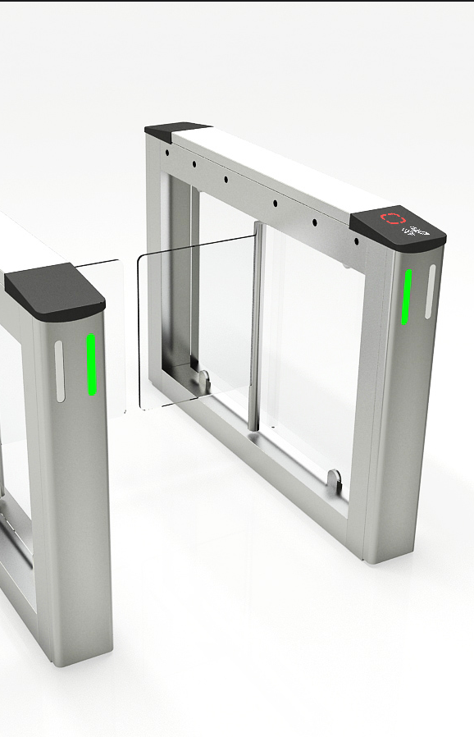
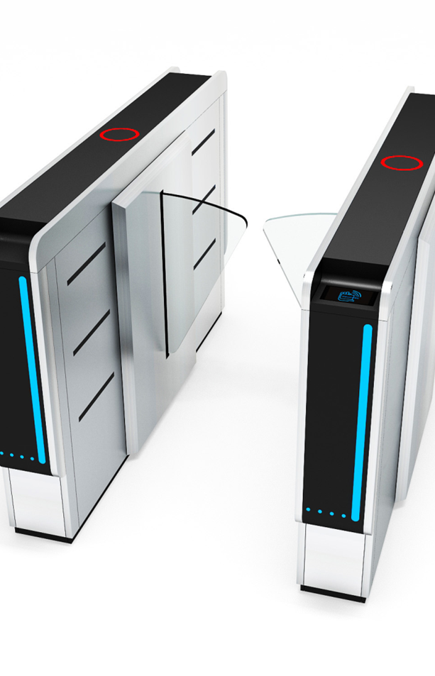
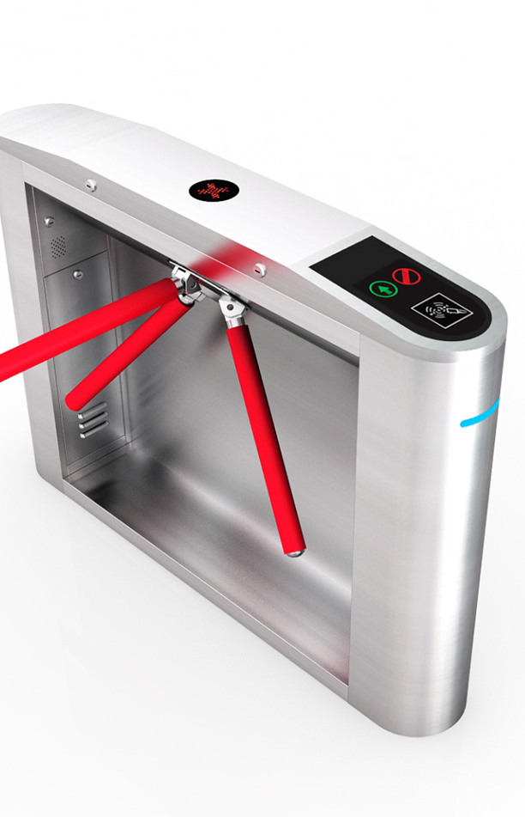


05 Global Product Type Analysis (2025)
Swing Barrier35.2%
Market leader with balanced security & efficiency, most versatile applications.
Flap Barrier28.7%
Fastest passage, high anti-tailgating, ideal for high-traffic areas.
Tripod Turnstile18.5%
Low cost, simple & durable, popular for outdoor & basic security.
Speed Gate12.6%(Fastest Growth)
Preferred for premium buildings; represents "frictionless access" trend.
Full Height Turnstile5.0%
Highest physical security; used in industrial parks, prisons, ports.

Slide 15
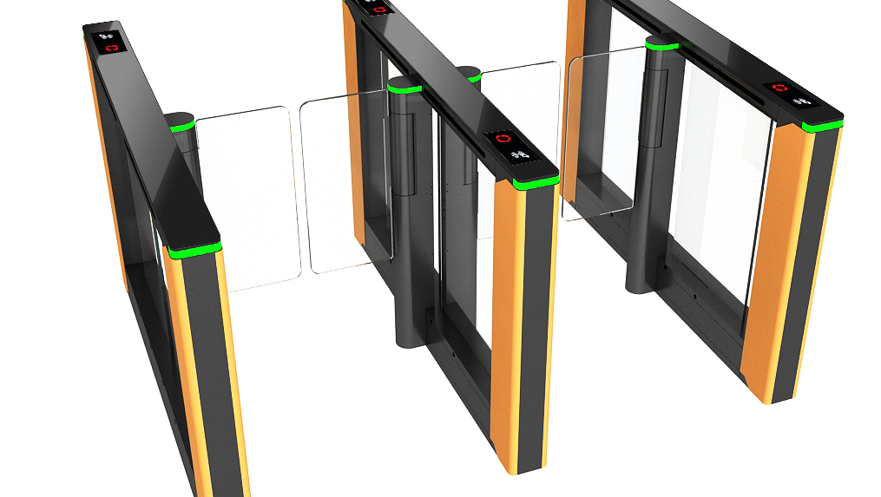
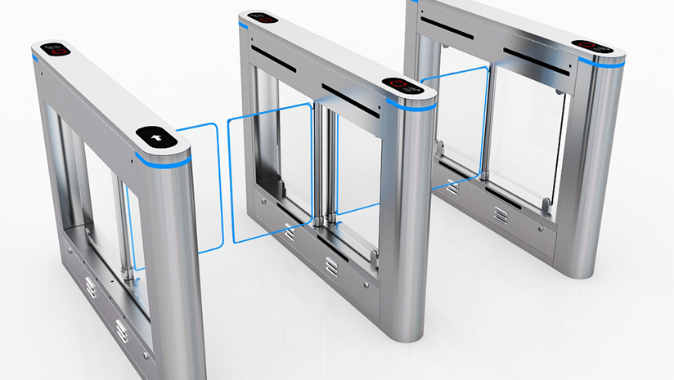
05 Global Price Tier Distribution (2025)
Mid-range · 46.0%(Market Mainstay)
💲 Price Range
$2000 - $6000
📦 Main Products
Standard Swing/Flap Gates
🌍 Core Markets
China, India
Premium · 25.0%
💰 Price Range:$6000 - $15000
📦 Main Products:Speed Gates, Multi-modal Turnstiles
🌎 Core Markets:Europe, US, Middle East
Budget · 29.0%
💸 Price Range:$500 - $2000
📦 Main Products:Tripod/Simple Swing Gates
🌍 Core Markets:Africa, SE Asia, Latin America

Slide 16

06 Summary of Core Demand Characteristics in Global User Markets
Mature Markets(Europe, Americas, Middle East)
Emerging Markets(APAC, LATAM, Africa)
✦ Core Needs:High security level, seamless access experience, strict privacy compliance (GDPR), high-end customization capabilities for specific scenarios, and cross-system interoperability.
✦ Core Needs:Ultimate cost-effectiveness, basic security, adaptability to complex environments, and responsive localized after-sales service.
✦ Preferred Products:High-performance speed gates, swing barriers, flap barriers; integrated biometrics (face/fingerprint) & NFC, pursuing ultimate stability.
✦ Preferred Products:Cost-effective swing/flap/tripod turnstiles; face/IC/QR recognition, balancing cost & usability.
✦ Price Acceptance
$6k - $15k / unit
Values quality & premium
✦ Representative Brands
Gunnebo, Boon Edam
Alvarado, Honeywell
✦ Price Acceptance
$800 - $5k / unit
Cost-efficiency first
✦ Representative Brands
Jieshun, Fuji, Hikvision
Dahua, ZKTeco, Hongmen

Slide 17

THANKS
Note: Data in this report refers to authoritative industry research institutions and public research materials such as WiseGuy, Reports, Global Info Research, China Report Hall, Mobile Sohu, Shunqi Network, and Guard God Technology Industry White Paper, covering measured data and segmented market research results from 2023 to 2025.
Thank You
Looking forward to further communication · Exploring the future together

